Slide 1
CASH TRANSACTION FRAUD DETECTION
Presented By:
NAME : SELVAKUMAR S
COLLEGE : SRIVIDYA COLLEGE OF ENGINEERING &TECHNOLOGY
DEPARTMENT : MECHANICAL ENGINEERING

Slide 2
OUTLINE
Problem Statement
Proposed System/Solution
System Development Approach
Algorithm & Deployment
Result
Conclusion
Future Scope
References

Slide 3
PROBLEM STATEMENT
Fraud detection is crucial for protecting businesses, consumers, and financial institutions from financial losses, reputational damage, and legal liabilities associated with fraudulent activities. It helps prevent fraudsters from exploiting vulnerabilities and safeguards assets and sensitive information.

Slide 4
PROPOSED SOLUTION
Get to Know Your Customers.
Use Fraud Prevention Software.
Monitor Unusual Behavior Everywhere.
Watch Out for Transactions that Don't Generate Money.
Work Together with Your Payment Processor.
Stay Current with Transaction Fraud Trends.

Slide 5
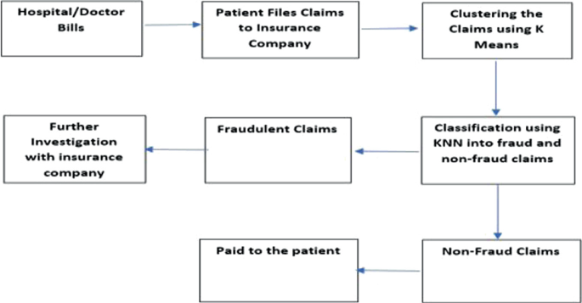
SYSTEM APPROACH

Slide 6
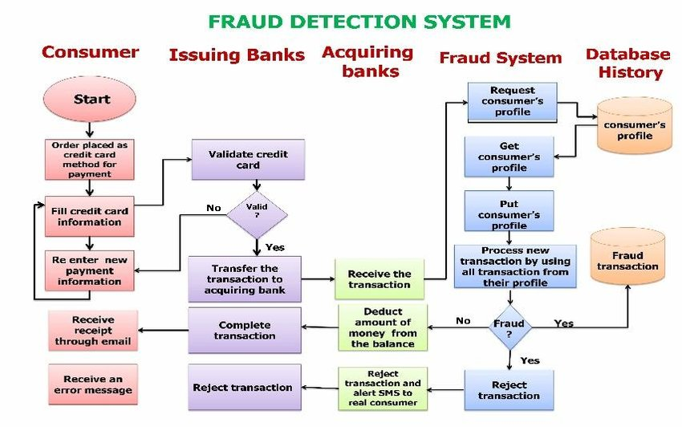
ALGORITHM & DEPLOYMENT

Slide 7
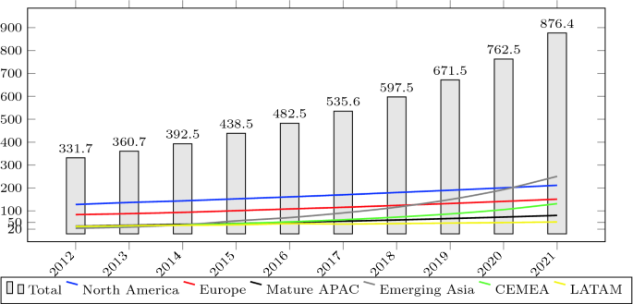
RESULT →The detection of cash frauds and funds transferring illegal manner is identified and rectified by using data science.

Slide 8
CONCLUSION →The applications of data science and its conceptual programming is utilised in this project by prediction of cash transaction is monitored and verified by this project.

Slide 9
FUTURE SCOPE
Traditional Fraud Detection Methods :
Traditional fraud detection methods rely on rule-based systems that look for specific patterns of behavior. These systems are often rigid and inflexible, making it difficult to adapt to new types of fraud. They also tend to generate a high number of false positives, which can be time-consuming and costly to investigate.
Machine Vision :
Machine vision is a technology that uses computer vision to analyze images and videos. This technology can be used to detect fraudulent activity in a variety of settings. For example, machine vision can be used to detect counterfeit goods or identify individuals in surveillance footage.

Slide 10
REFERENCES
Al Barsh, Y. I., et al. (2020). "MPG Prediction Using Artificial Neural Network." International Journal of Academic Information Systems Research (IJAISR) 4(11)
N. Kumari and J. Khanna, “Cashless payment: A behaviourial change to economic growth,” Qualitative and Quantitative Research Review, vol. 2, no. (2), 2017
A. Junita and S. Abdullah, “Pengaruh Fiscal Stress Dan Legislature Size Terhadap Expenditure Change Pada Kabupaten/Kota Di Sumatera Utara,” J. Akunt., vol. 20, no. 3, 2017
J. Pal, P. Chandra, V. Kameswaran, A. Parameshwar, S. Joshi and A. Johri, “Digital payment and its discontents: Street shops and the Indian government's push for cashless transactions,” In Proceedings of the 2018 CHI Conference on Human Factors in Computing Systems (pp. 1-13), 2018
S.S. Halbouni, N. Obeid, and A. Garbou, “Corporate governance and information technology in fraud prevention and detection: Evidence from the UAE,” Manag. Audit. J., vol. 31, no. 6–7, 2016.
] Sekilas tentang Control Objective for Information and related Technology (COBIT) diakses dari http://cobitindo.blogspot.com/2011/10/sekilas-tentangcontrol-objective-for.html#more.

Slide 11
THANK YOU

